Slide 1
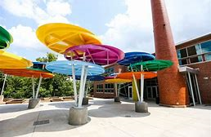
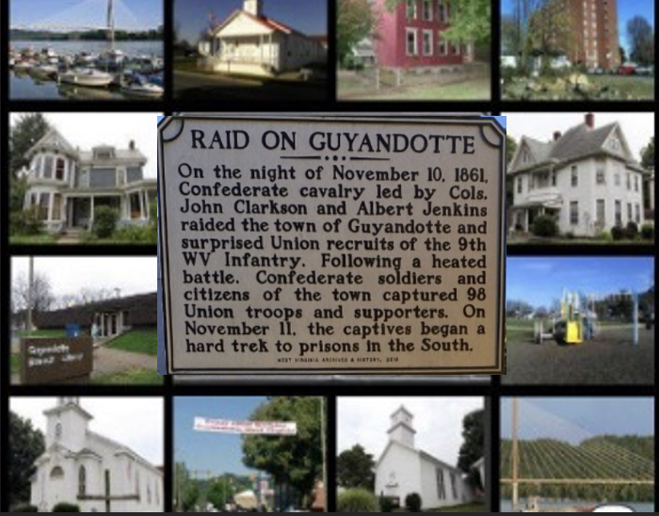
#10 - Guyandotte Methodist Church Cemetery, located along 5th Ave.
Conclusion: The 5th grade
students under the guidance of Mr. Lamp, Ms. Huggins, and Ms. Lalos worked hard to create this authentic document about the historical homes and locations in Guyandotte, WV.
“A War Close to Home”
#11 - Hysell House, 302 Main St.
Guyandotte Historical Tour 2021-2022
We would like to give a big thanks to Ms. Davis, Explorer’s Instructional Guide for being our Civil War Field Expert!
#12 - Victor LeTulle House, 268 Guyan St.
Created by : The 5th Grade Crews at Explorer Academy
#13 - Buffington- House, 101 Main St.
EXPLORER ACADEMY
2901 Saltwell Road Huntington, WV 25705
Phone :304 528 5126
Fax : 304-528-5150
#14 -First Guyandotte Baptist,
291 Richmond St.
Notes:
To change this brochure, replace our sample content with your own. Or, if you'd rather start from a clean slate, press the New Slide button on the Home tab to insert a new page. Now enter your text and pictures in the empty placeholders. If you need more placeholders for titles, subtitles or body text, copy any of the existing placeholders, then drag the new one into place.
And did you notice we made fold marks for you? They are really light, but if you don’t like them showing on your brochure, select and delete them before you print.

Slide 2
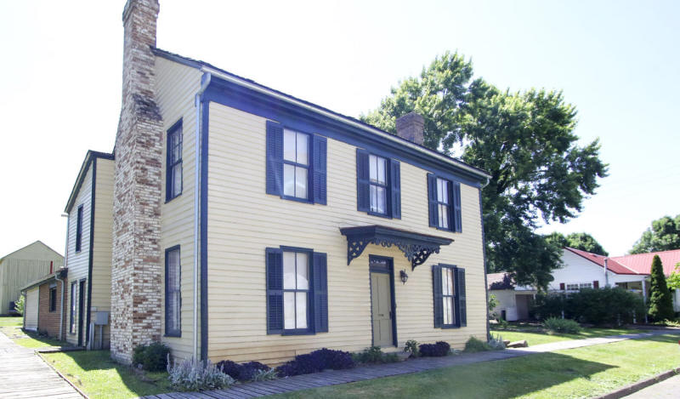
#5 - McCune House, Main St.
Expedition: Battle of Guyandotte
#1 - Crawley Hotel, 307 Water St.
Overview: Our 5th grade students visited twelve different historic locations in Guyandotte, WV in October 2021. Armed with note-catchers, iPads, and the local historical knowledge from Mr. Lamp, Ms. Huggins and Ms. Lalos, three Explorer Academy 5th grade teachers, they authentically documented their experiences at each historical location in relation to the Battle of Guyandotte which occurred at the onset of the Civil War on November 11, 1861. Using these experiences, students created uniquely designed iMovies to highlight and describe each of the individual locations they visited. Each distinct location and accompanying video can be accessed via the QR code contained within this brochure.
#2 - John S. Witcher House,
108 Richmond St.
#6 - Fruetel-Hennen House, 313 Main St.
#3 - Keenan House, 232 Main St.
#7 - Z.T. Wellington House, 415 Main St.
#8 - Maddie Carroll House, 234 Guyan St.
#4 - Guyandotte United Methodist Church, 305 Main St.
#9 Roseberry House, 240 Main St.
Notes:
To change this brochure, replace our sample content with your own. Or, if you'd rather start from a clean slate, press the New Slide button on the Home tab to insert a new page. Now enter your text and pictures in the empty placeholders. If you need more placeholders for titles, subtitles or body text, copy any of the existing placeholders, then drag the new one into place.
And did you notice we made fold marks for you? They are really light, but if you don’t like them showing on your brochure, select and delete them before you print.

